Slide 1



Searching for Subsurface Ice in Hellas Planitia, Mars
Using Radar
Claire Cook, Dr. Shane Byrne, Ali Bramson
Lunar and Planetary Laboratory, University of Arizona
Space Grant Symposium
April 14th, 2018

Slide 2
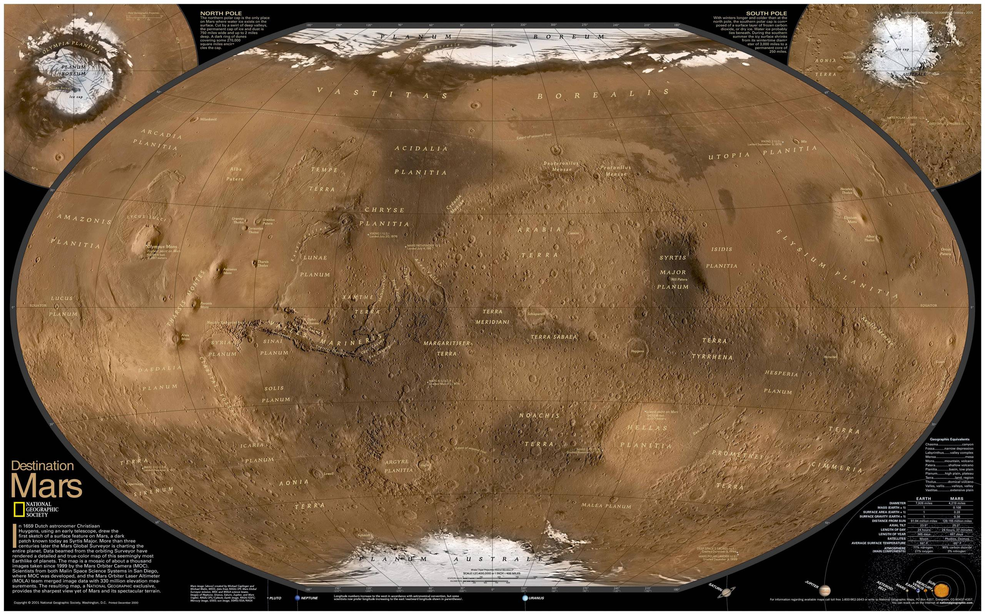
Notes:
At the poles: ice stable at the surface. In the equatorial regions: ice not stable at any depth. In the midlatitudes: ice stable in the near subsurface.

Slide 3

Introduction: Ice on Mars
Could be a resource for future human exploration
Gives insight into Mars’ climate history
  Purity
  Distribution
  Depth
Image credit: NASA/Pat Rawlings
Notes:
Purity: did subsurface come from precipitation onto the surface (now buried) or diffuse into the soil? Distribution: is it associated with certain features and what does that say about the origin of those features? Depth: how much ice is there?

Slide 4
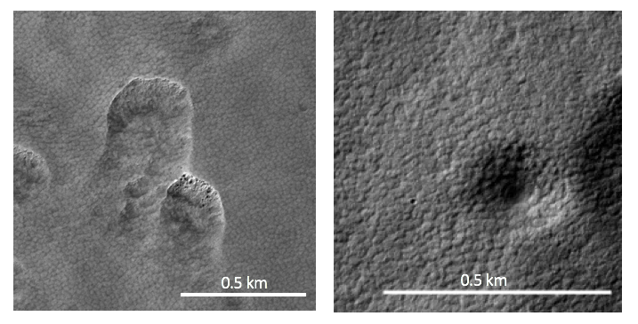
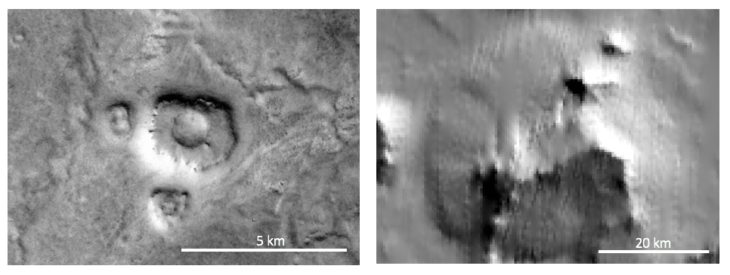
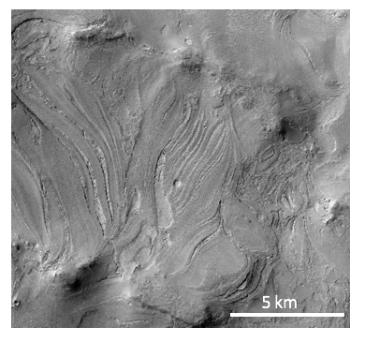
Signs of Subsurface Ice
Scallops and expanded craters: collapse by sublimation of subsurface ice
Pedestal craters: ice armored by ejecta, lost in surroundings
Lobate debris apron: debris covered glaciers
Banded terrain: possible viscous flow of an ice layer
Scalloped depressions
Expanded craters
Pedestal craters
Lobate debris apron
Banded terrain
Notes:
Scallops and expanded craters: collapse by sublimation of subsurface ice. Pedestal craters: ice armored by ejecta, lost in surroundings. Lobate debris apron: debris covered glaciers. Banded terrain: possible viscous flow of an ice layer. All of these found in Hellas Planitia.

Slide 5
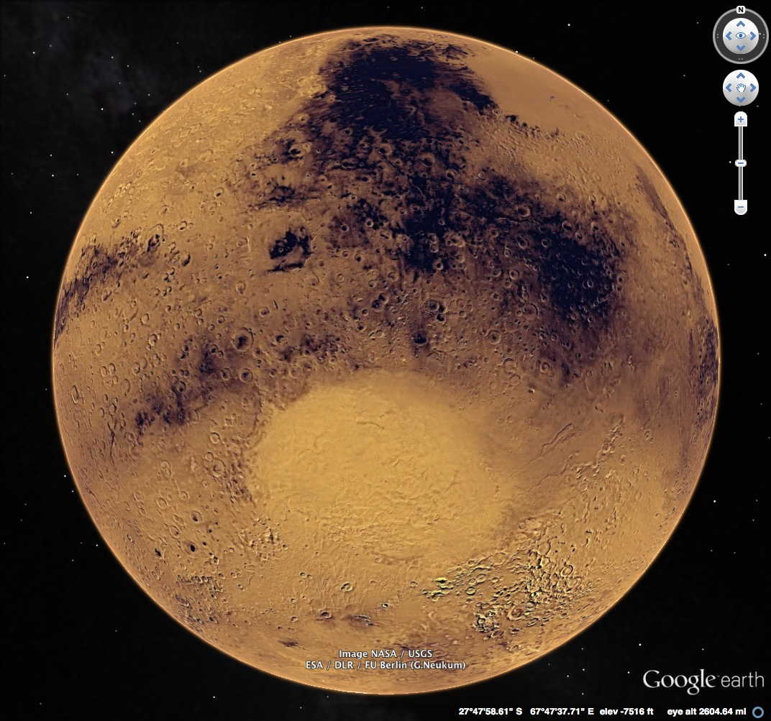
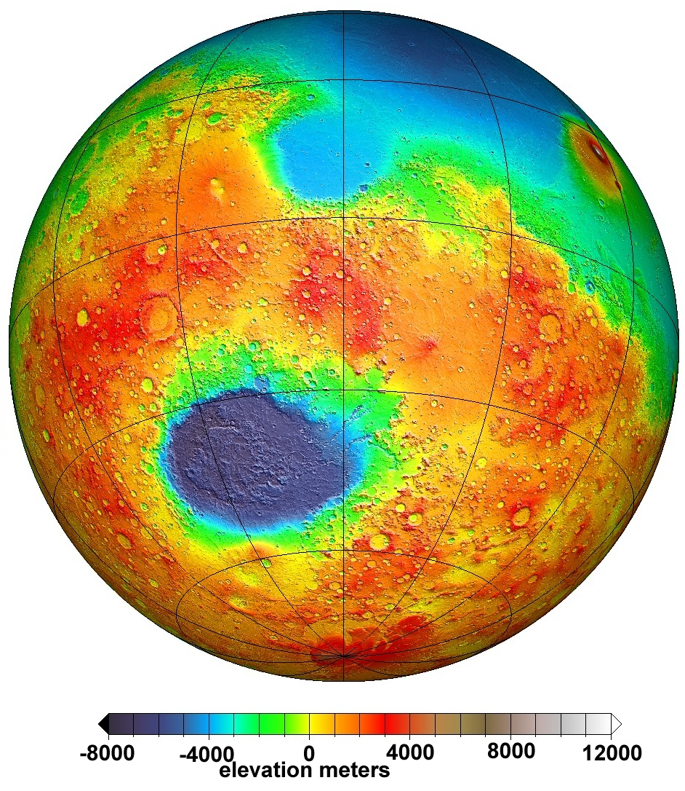
Hellas Planitia
Hellas Planitia
Image credits: NASA
Notes:
Hellas Planitia: big crater in the southern hemisphere

Slide 6
What are the properties of ice in Hellas Planitia?

Slide 7
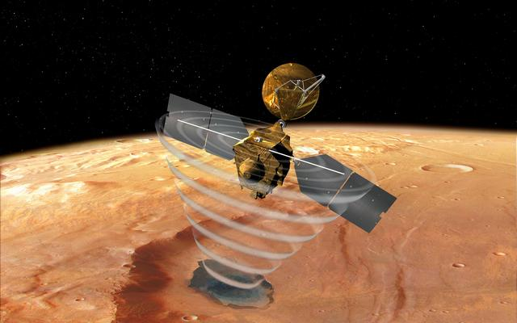
Methods: Radar
Allows us to probe the subsurface
  Radar reflects off the interface between materials with different dielectric constants
  Dielectric constant relates to the speed at which electromagnetic waves move through a material
SHAllow RADar (SHARAD) on the Mars Reconnaissance Orbiter
  Looked at radargrams for 368 tracks covering Hellas Planitia
Image credit: NASA/JPL
Notes:
Interfaces: Atmosphere-surface. Ice-rock.

Slide 8
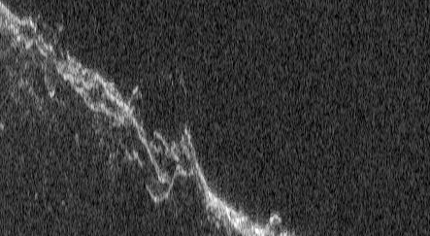
Radargram
Time delay
Distance along track
Notes:
Spacecraft passing over a length of the ground and sending down radar. Here we see the time delay the signal took to come back vs the distance along that track. First return: atmosphere-surface interface generally. we’re looking for returns after that.

Slide 9
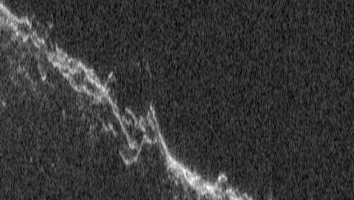
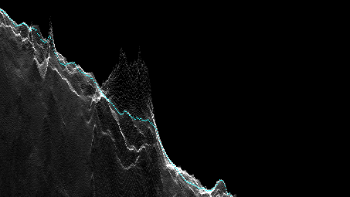
Methods: Clutter
Reflections from off-nadir surface topography
Can appear at delay times similar to subsurface reflectors
To avoid: compare to simulations of what the radar would see based solely on surface topography
Radargram
Clutter simulation

Slide 10
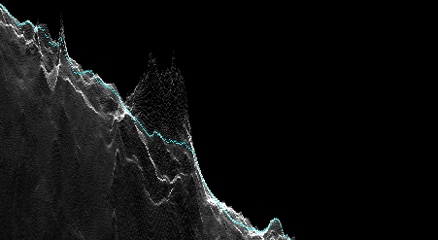
Clutter simulation
Time delay
Distance along track

Slide 11
Radargram
Time delay
Distance along track
Notes:
Point out the reflector

Slide 12
Clutter simulation
Time delay
Distance along track

Slide 13
Radargram
Time delay
Distance along track
Notes:
Point out the reflector

Slide 14
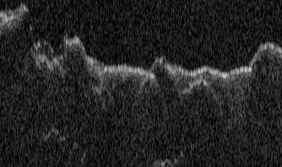
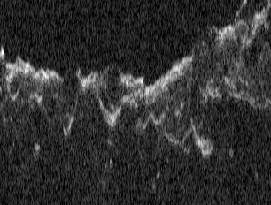
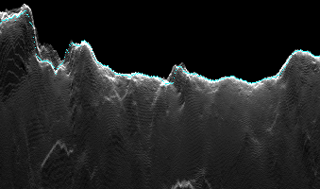
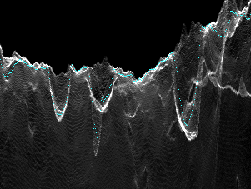
Methods: Confidence Rating
Lower confidence in those that are absent from the simulations but contiguous with clutter or have some curvature, which is common to clutter
Higher confidence in those that are not contiguous with clutter or curved
Contiguous with clutter
Curved
Notes:
Point out the reflectors

Slide 15
Methods: relationship to ice features
For reflectors we have higher confidence in, looked at Context Camera (CTX) images of the area to identify features potentially associated with ice
Scalloped depressions
Expanded craters
Pedestal craters
Lobate debris apron
Banded terrain

Slide 16
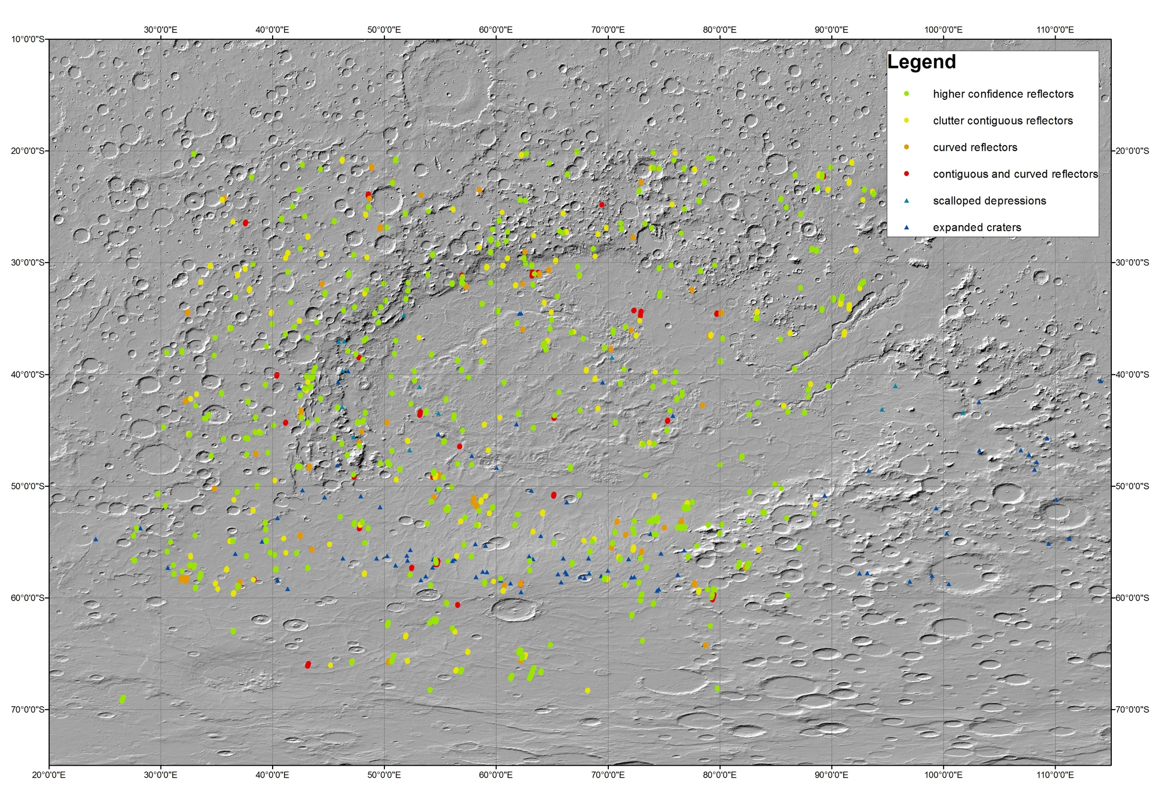
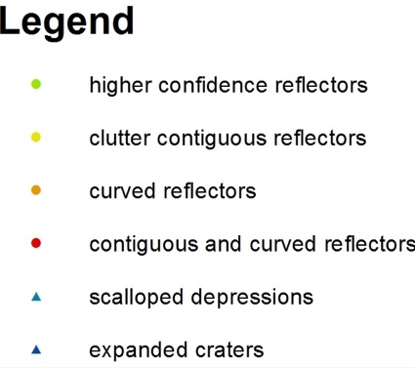
20°S
40°S
60°S
Scallops and expanded craters from Viola D. and McEwen A. S. (2018), JGR
20°E
40°E
60°E
80°E
100°E
Notes:
S

Slide 17
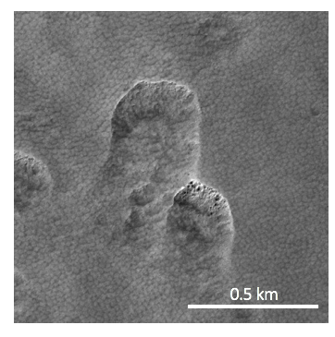
Results: 649 reflectors
Higher confidence: 413
Scalloped depressions: 23
Pedestal craters: 3
Near but not associated with pedestals themselves: 18
Lobate debris apron: 1
Banded terrain: 5

Slide 18
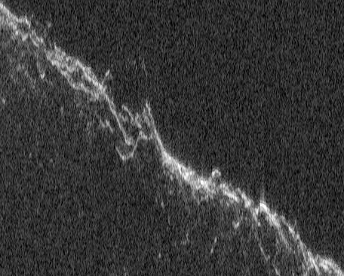
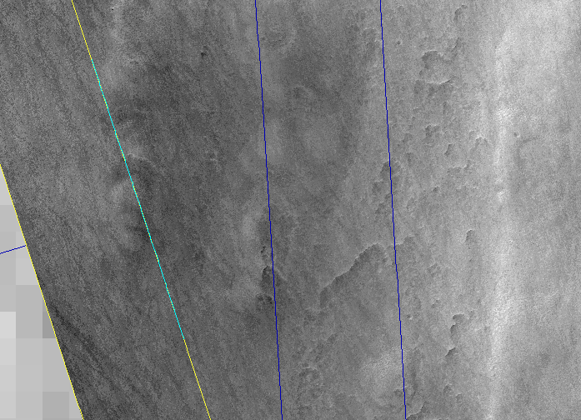
Scalloped Depressions
4 km
4 km
Radargram
Overhead view
Notes:
The lines across the overhead view show tracks. The yellow one corresponds to the radargram shown and the cyan marks the reflector.

Slide 19
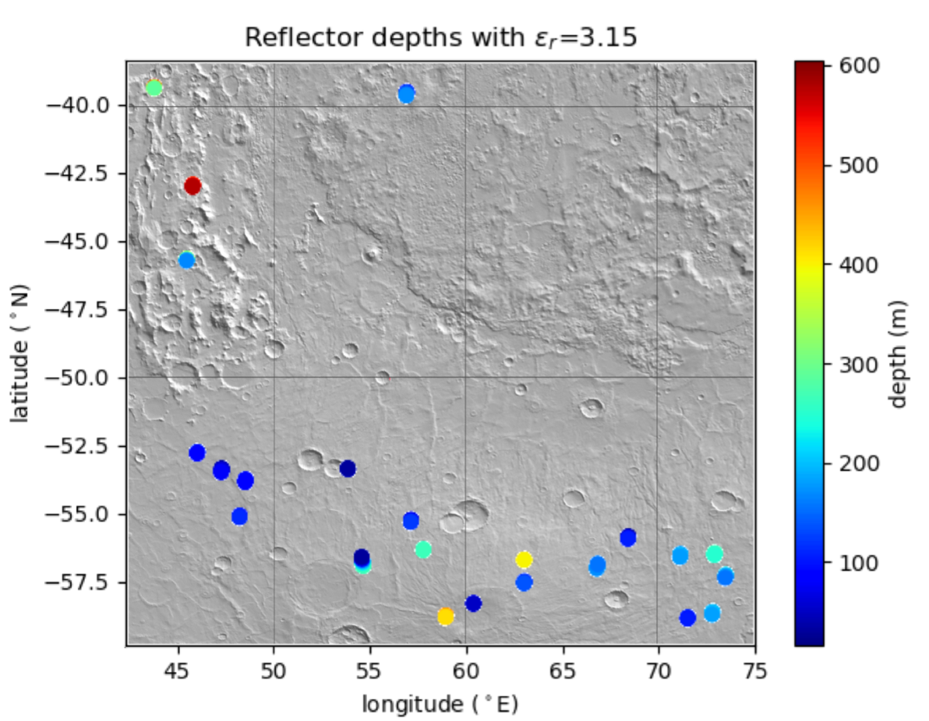
Scalloped Depressions
Calculated depth of the reflectors assuming a dielectric constant of ε_{r} = 3.15 (pure ice)
Median depth of reflectors with this dielectric constant: 165 m
Scallops typically 10-20 m deep
Notes:
Plot: each point is one of the reflectors found near scallops, showing its depth with dielectric constant 3.15.

Slide 20
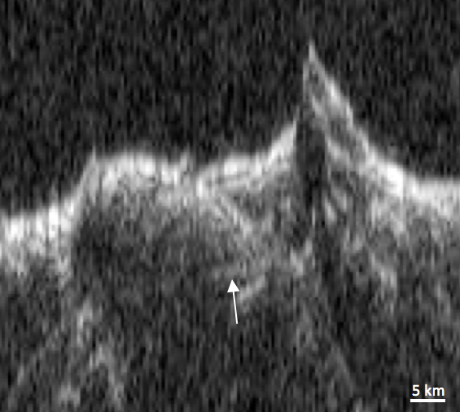
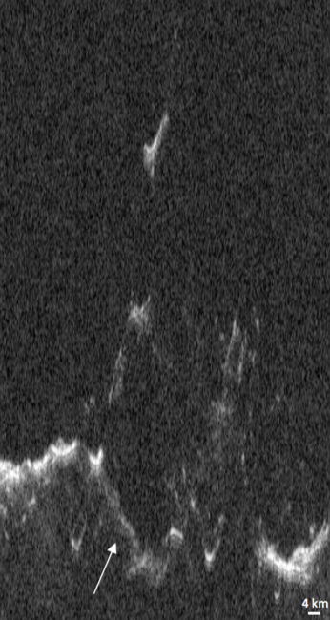
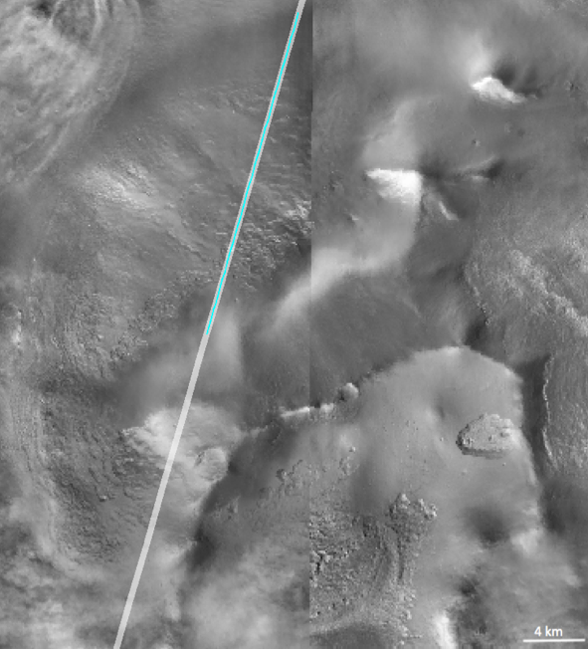
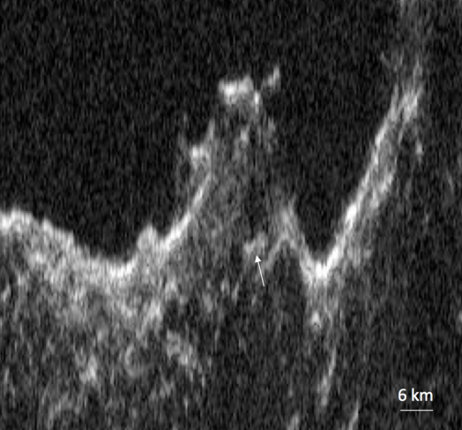
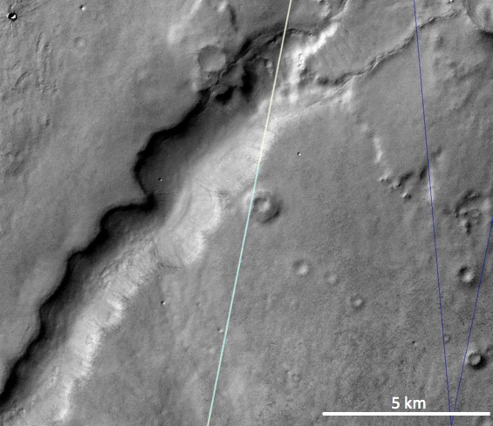
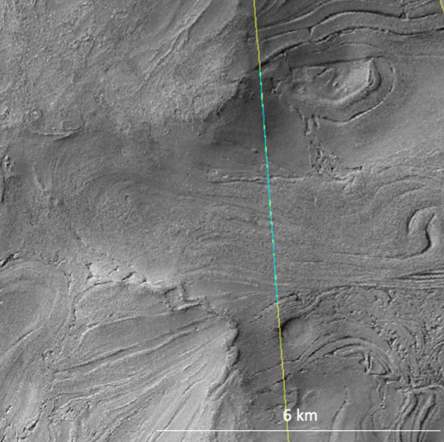
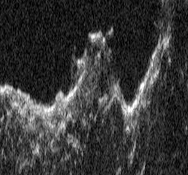
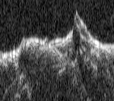
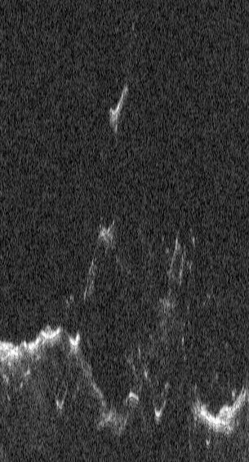
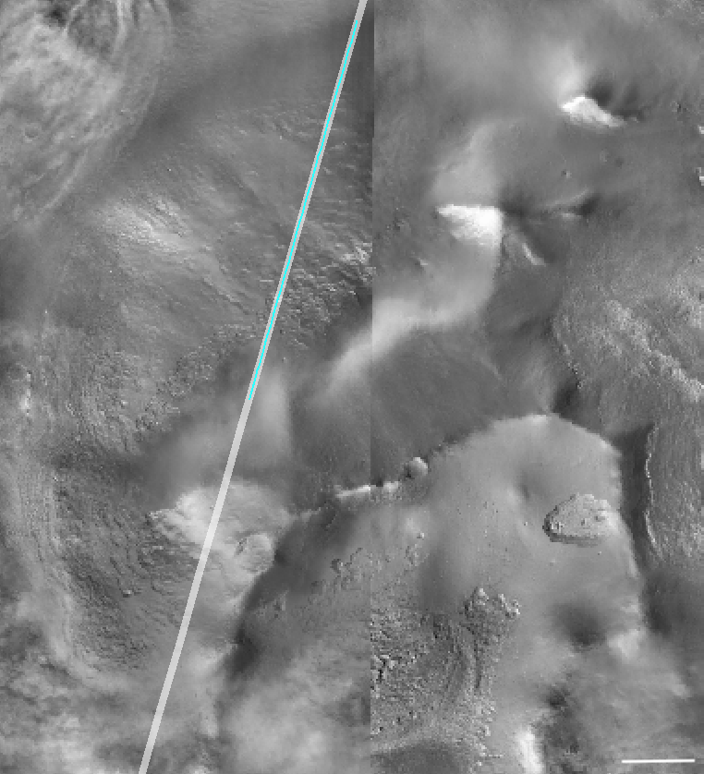
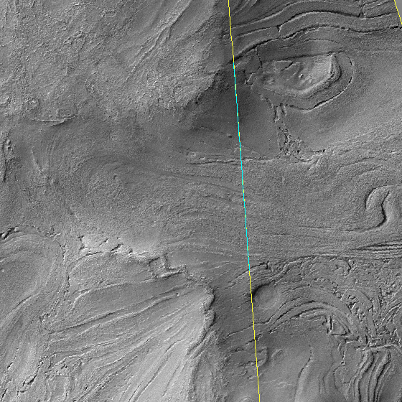
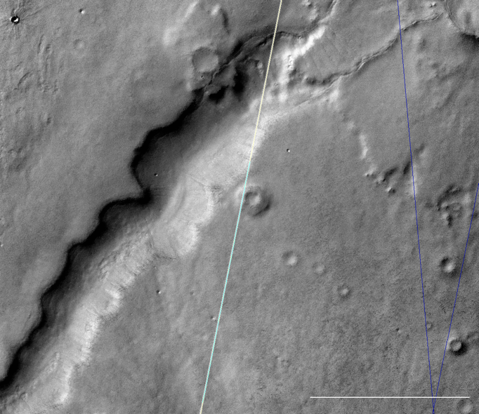
Other features: ice thicknesses
Pedestal craters
Lobate debris apron
Banded terrain
103 m
Up to 1 km
265 m on average
6 km
5 km
4 km
4 km
5 km
6 km

Slide 21
Conclusions
We found radar reflectors near terrain associated with ice in Hellas Planitia
These reflectors allow us to constrain the thickness of the ice
  Reflectors are 100s of meters deep if associated with the bottom of the ice layer
Future work:
  Additional analysis of reflectors near scalloped depressions to determine ice purity
  Additional analysis of reflectors near other features like pedestal craters
Notes:
Additional analysis: depth corrected radargrams

Slide 22

Acknowledgements
Jack Holt and Michael Christoffersen provided the clutter simulations

Slide 23
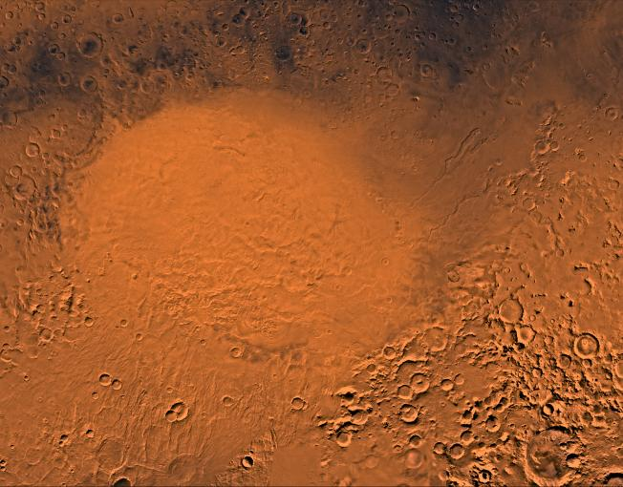
Thank You
Notes:
Ended up at ~6:20

Slide 24
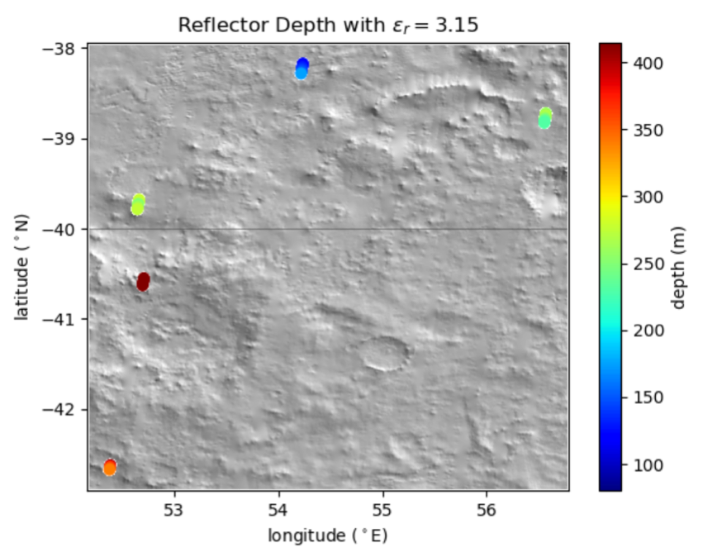
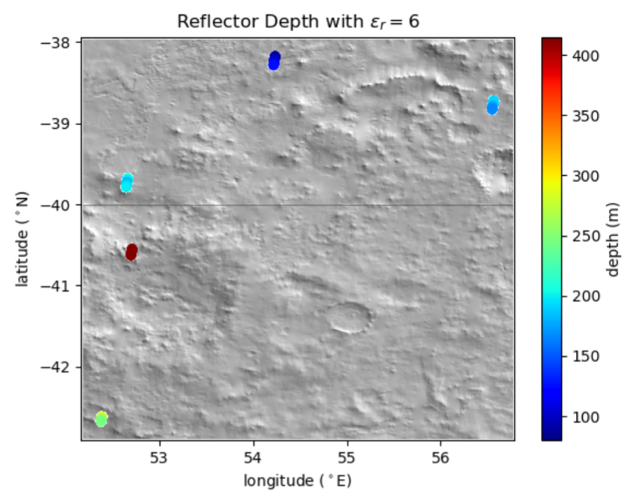
Banded Terrain
Ice and salt-related processes have been suggested for the origin of this terrain.
Calculated depth of the reflectors assuming ε_{r} = 3.15 (pure ice) and ε_{r} = 6 (salt).
The median depth with ε_{r} = 3.15 is 265 m and with 6 is 192 m.

